Slide 1
A0 사이즈, IDEC 템플릿 이용, 자유 레이아웃
예시)
제목, 저자, 소속 등 논문 정보
서론
서술형 또는 요약형으로
2항목 이상
본론
개념 및 기술, 회로 설계 및 제작, 칩 측정 결과 등 (예시)
구체적인 내용 작성
결론
서술형 또는 요약형으로
2항목 이상

Slide 2
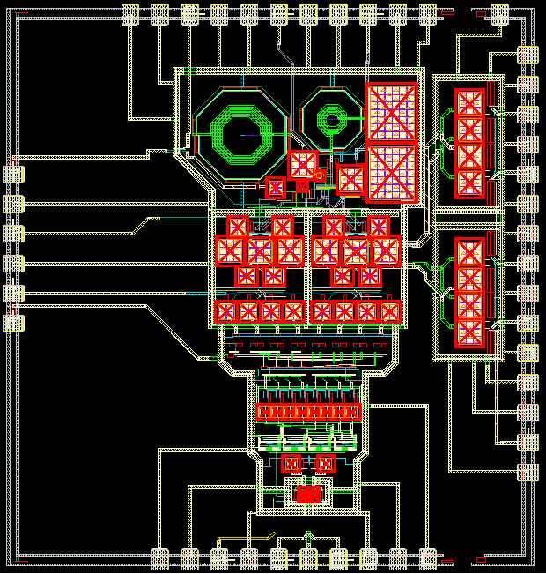
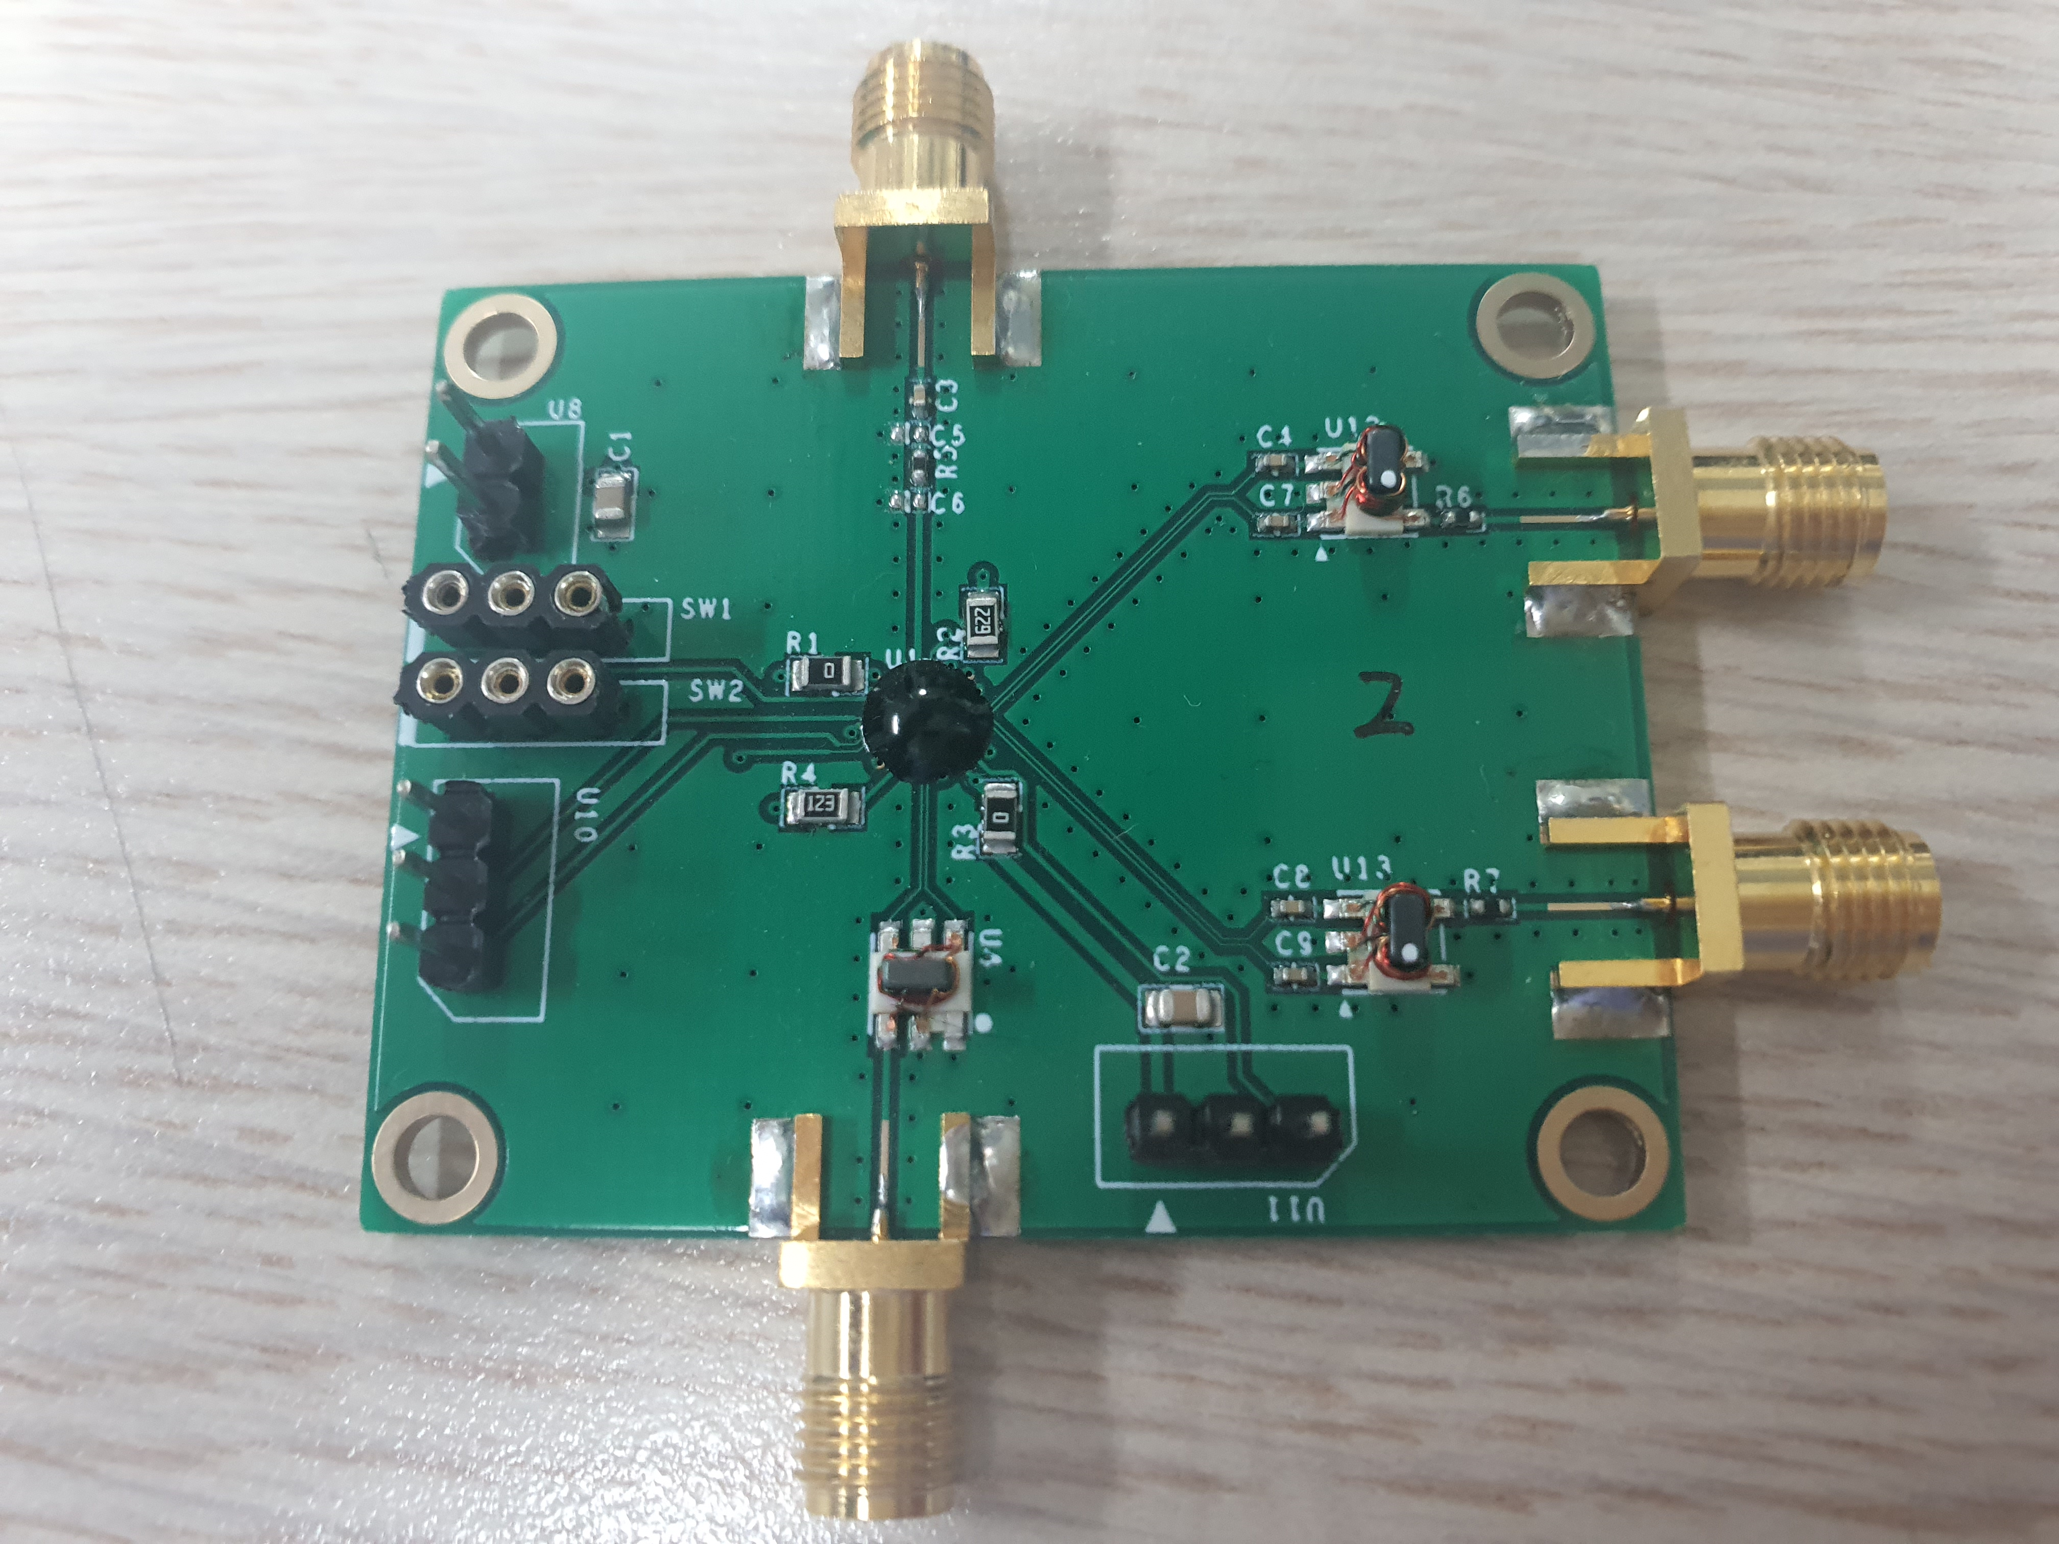
A Passive Mixer-Based Sub-GHz Receiver Front-End for Fast Spectrum Sensing Functionality
Dongmin Kim and Donggu Im
Department of Electronic Engineering, Jeonbuk National University
The Internet of Things (IoT) has influence in various fields such as health care, smart homes, smart cities, and smart factories. It is predicted that the number of connected IoT devices will increase from 27 billion in 2017 to 73 billion in 2025. In the near future, it will be necessary to efficiently manage the massive increase in data communication traffic generated by the many IoT devices. To address this issue, cognitive radio (CR) technology will become a core technology for modern wireless communication receivers. Because this technology enables receivers to detect unused frequency bands (called by 'white space') for optimal communication conditions, it greatly improves the utilization of the scarce spectral resources and allows for more efficient management of wireless data traffic.
One of the main challenges for CR technology is the implementation of fast and accurate spectrum sensing functionality in wideband. It is necessary to reliably identify primary users before deciding the various technical specifications of wireless transmission for the secondary users (i.e. frequency, channel, access, and modulation formats). In addition, radio signals are crowded in the sub-GHz frequency band due to existing wireless standards such as digital TV, 3G/4G cellular, low-power wide-area network (LPWAN), and ZigBee. This means that the receiver front-end for CR technology should solve the problem of signal corruption caused by local oscillator (LO) harmonic mixing during spectrum sensing. And as a result, new receiver architecture is required to minimize the spectrum sensing time while ensuring excellent sensitivity and selectivity performance.
<Schematic of Receiver>
In this work, we proposed an RF-to-BB receiver architecture in which DC bias current is shared between an LNA and a transimpedance amplifier (TIA). A wideband impedance matching characteristic is achieved using resistive feedback, and single-to-differential (S2D) is implemented through a source-follower buffer. A double-balanced current mode passive mixer driven by a non-overlapping 25% duty-cycle LO was used to realize the frequency down-conversion, which could increase the conversion gain, reduce the nois, and enhance the linearity of the arcutecture.
<Photograph of Layout and Measurement Results>
The designed receiver showed a conversion gain of 34.5 dB, a NF of 13.1 dB, and an input return loss of less than -10 dB at 0.1-1 GHz. The measured IIP3 of the designed receiver was -27.5 dBm with the same dc power consumption in the simulation.
<Measurement PCB Board and Conclusion>
A wideband RF-to-BB receiver operating 0.1-1 GHz is proposed for IoT applications. The proposed receiver was designed using 65-nm CMOS process, and showed an NF performance of less than 7.3 dB with lower power consumption in the simulation. However, in the measurement, the performances were much worse than the simulation results with the same dc power consumption. The cause of the degradation is estimated to be a loss due to the load effect by sharing the output of the mixer and the output of the receiver and path loss on the PCB.
<Simulation Results>
The proposed receiver was designed using a 65-nm CMOS process, and showed a NF of less than 7.3 dB, a conversion gain (CG) of 33.7 dB, and an input return loss (S11) of less than -10 dB over 0.1-1 GHz in the simulation. The simulated IIP3 of the designed receiver was -27.2 dBm with dc power consumption of 15.9 mW.
<Acknowledgement>
The chip fabrication and EDA tool were supported by the IC Design Education Center (IDEC), Korea.

